Slide 1
RSET
Calculate the required safe egress time

Slide 2
Historic Fire
Shanghai Apartment

Slide 3
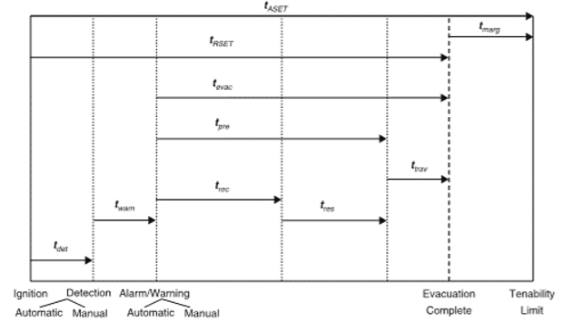
Time
Detection and notification
Reaction
Pre-evacuation
Travel time

Slide 4
Effective Width
Boundary layer

Slide 5
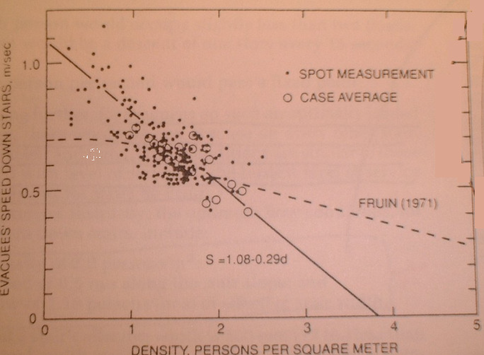
Movement Times
SFPE equation
Pauls, Fruin, Predtechenskii and Milinskii
Beyond data collected
Not internally consistent
Age of data
Diversity of population
Distribution
No data to support k
Notes:
5

Slide 6
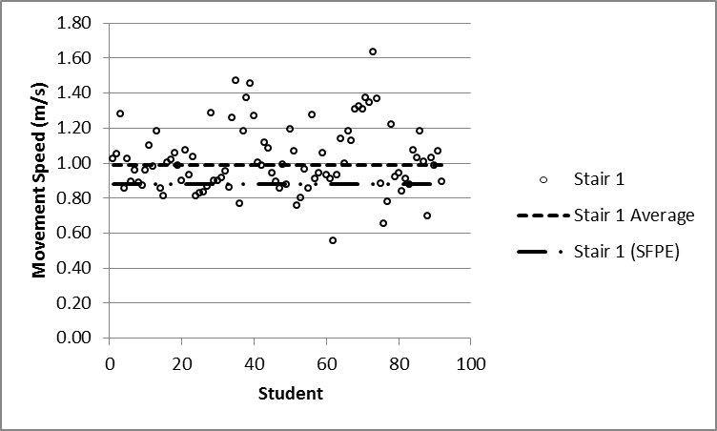
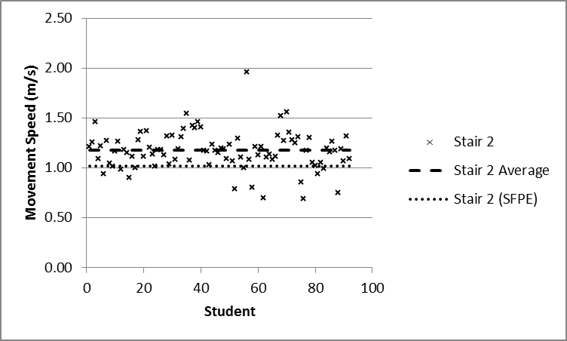
Observed Flows

Slide 7
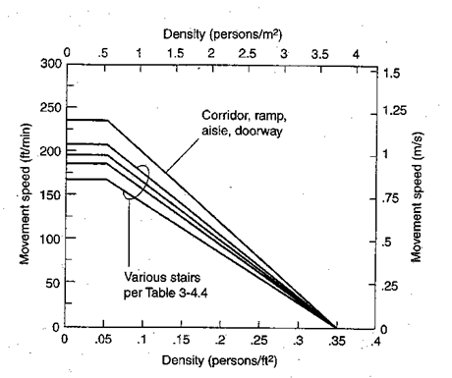
Movement Times
Where:
S=speed (ft/min or m/s)
k=constant (Table 4.2.5)
a=constant (2.86 when using ft, 0.266 when using m)
D=density (persons/ft² or persons/m²)
Notes:
7

Slide 8
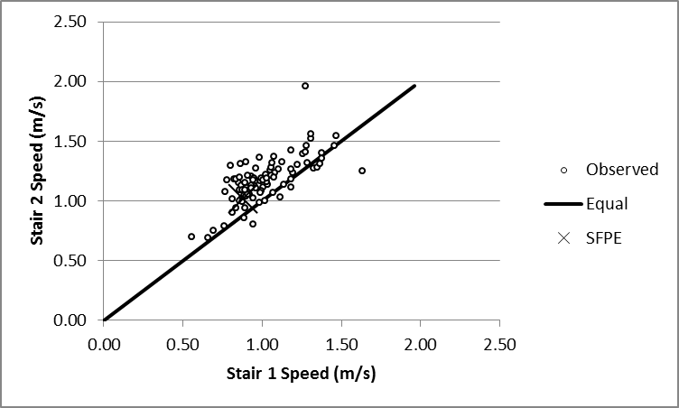
Justification of k-Factors
Element | k (U.S. units) | k (metric)
Corridor, door, ramp | 275 | 1.40
Stairs
Riser, Tread (in)
7.5, 10 | 196 | 1.00
7.0, 11 | 212 | 1.08
6.5, 12 | 229 | 1.16
6.5, 13 | 242 | 1.23

Slide 9
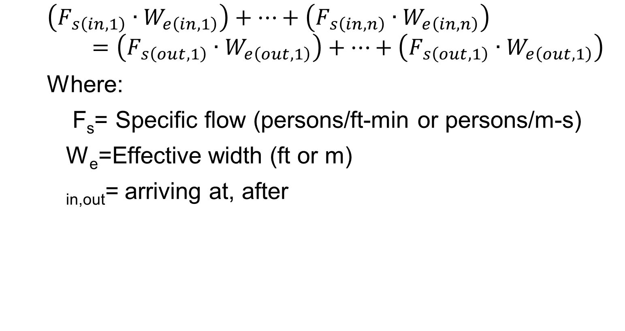
Movement Times
$$\left(F_{s\left(in,1\right)}∙W_{e\left(in,1\right)}\right)+…+\left(F_{s\left(in,n\right)}∙W_{e\left(in,n\right)}\right)=\left(F_{s\left(out,1\right)}∙W_{e\left(out,1\right)}\right)+…+\left(F_{s\left(out,1\right)}∙W_{e\left(out,1\right)}\right)$$
Where:
F_{s}= Specific flow (persons/ft-min or persons/m-s)
W_{e}=Effective width (ft or m)
_{in,out}= arriving at, after
Element | Boundary Layer (in)
Stairways | 6
Railing, handrails | 3.5
Theater chairs | 0
Corridor, ramp | 8
Obstacles | 4
Wide concourses | < 18
Door | 6
Notes:
9

Slide 10
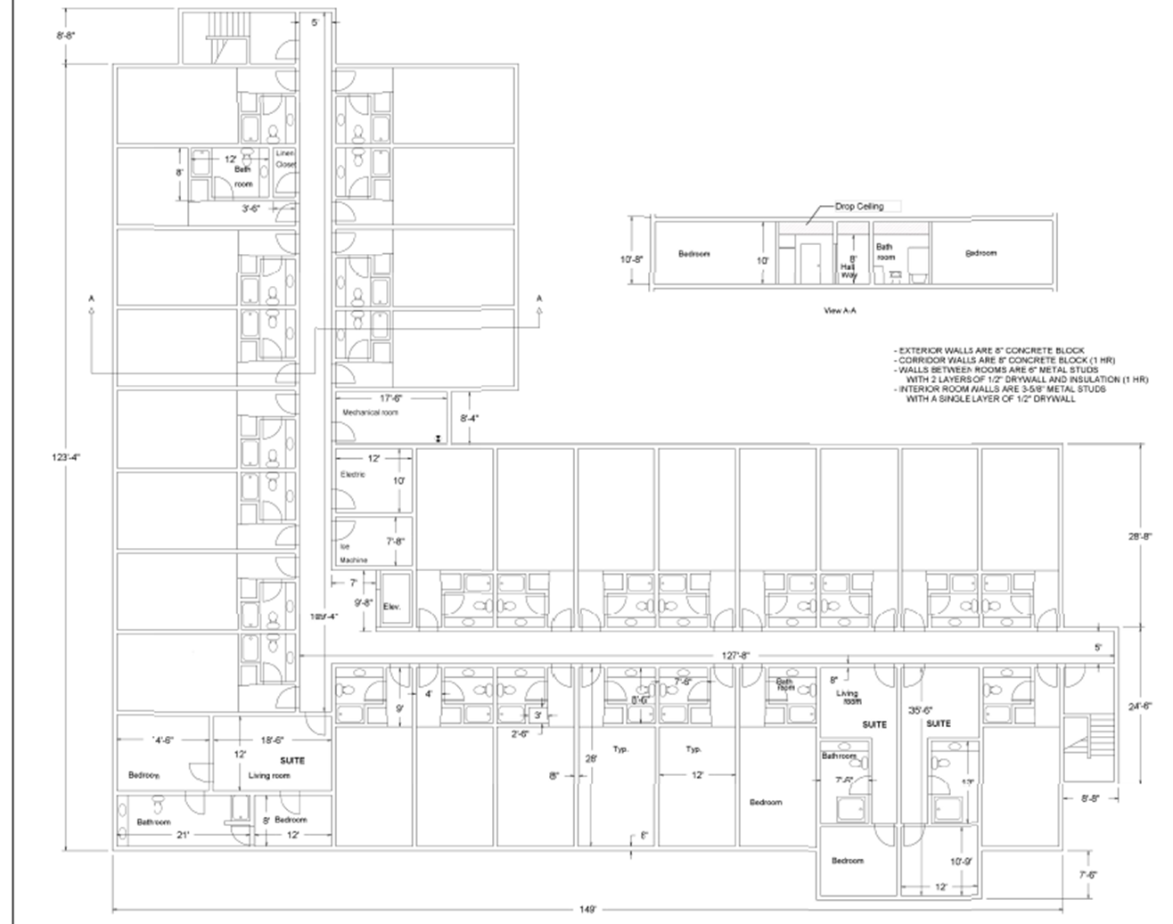
Movement Times
Calculations build
See example problem on 4-62 to 4-64 in NFPA Handbook
Consider limiting component
Notes:
10

Slide 11
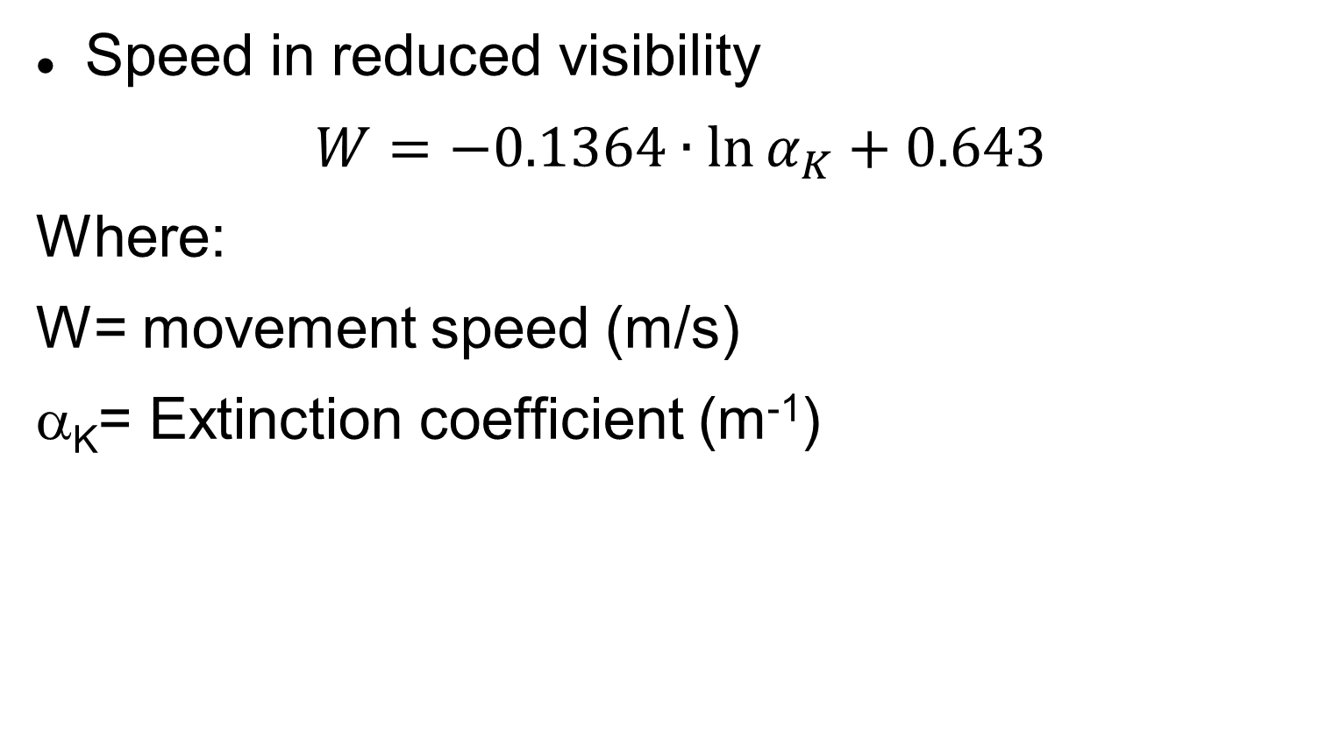
Movement Times
Speed in reduced visibility
$$W=−0.1364∙\ln{α_{K}}+0.643$$
Where:
W= movement speed (m/s)
α_{K}= Extinction coefficient (m⁻¹)
Notes:
11

Slide 12
Flow

Slide 13
Population Variability
Age
Fitness
Gender
Fatigue

